Slide 1
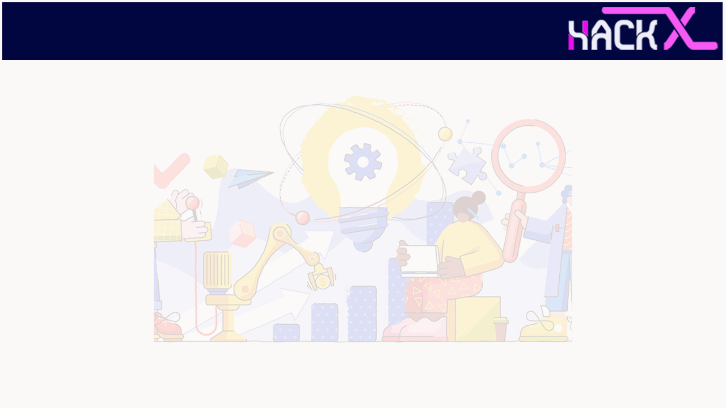
SLIDE 1
Team Name
Break_The_Chain
2. Members Name and Phone Numbers
Kartik Kumar (6206822839) (Leader)
Shashank Sinha (6380509191)
Siddartha Mareedu (9888405477)
3. Domain name
Open Innovation
4. Problem statement
Health Care For All
-> Innovative way of presenting a system of Healthcare for all to prevent deadly and contagious diseases.

Slide 2
SLIDE 2
ABSTRACT
Our model basically works machine learning predictions. The given model would record the symptoms which are experienced by the patient and would give 3 result (possible disease) that would be evaluated through three classification and regression models namely Random Forest, Decision Tree and Naïve Bayes algorithm.
Further this model will be available as a self-made UI / UX models which would give a better experience to the users. Our UI/UX models will be available on web platform.
We will be basically providing the necessary remedies and valuable data using web scrap to make searching efficient and further assist the user to take the precautions which will in turn save the time.

Slide 3
SLIDE 2
ABSTRACT
We have also taken specially-abled people into consideration, in which the options available to the user will read through a python code and further actions will be fully assisted.

Slide 4
SLIDE 3
NOVELTY
As there are a very few web apps which provide an account of the problems faced by our patients hence we won’t be using any open source which is an add on as there won’t be any repetitive designs and hence our web app would stand out as a good initiative .
The data will be provided explicitly without any premium features so that everyone can use the web app without any restrictions and the data.
With good web scraping we plan to take it to the next level to provide explicit and valuable data to the users .
The prediction will be based on thorough calculations and not just any random data.

Slide 5
SLIDE 4
TECHNOLOGY STACK
Python
Figma
Dataset and content from website.
Machine Learning
Web Scraping

Slide 6
SLIDE 5
SOFTWARE IMPLEMENTATION
Our product would be implemented as a Functioning Web App and the design prototype would be taken care of in the Figma .

Slide 7
SLIDE 6
BUSINESS SCOPE
The data will be provided explicitly without any premium features so that everyone can use the web app without any restrictions and the data.
We plan to expand the reach of the Web App through proper advertising so that it reaches a wider section of audience especially the targeted ones which include the age group of 50-80.

